Slide 1


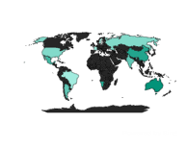
Human Resource Dashboard / overview
Filter
HR
Overview
Active Employees
7984
Hired Terminated
8,950 966
Demographics
Gender
Age & Education
Performance &Education
c
Export
Department
Income
Location
Gender & Education
Age VS Salary
Connect
Salary
Age
HQ
Branches

